Slide 2

Welcome
Project overview
Q & A
Icebreaker question
Group photo!!

Slide 3
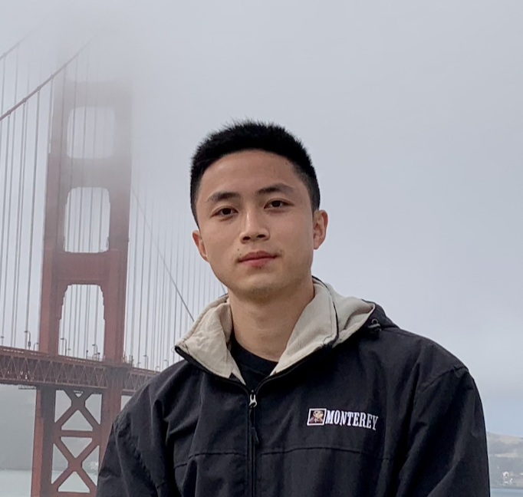
Project Leader
Yuan Sun (he/him)
Senior Software Engineer, Otter.ai
Computer Science Fellow, Open Avenues
LinkedIn
yuan.sun@openavenuesfoundation.org
Project Hub link

Slide 4


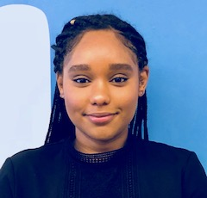
Open Avenues Team
Danielle Goldman (she/her/hers)
Co-Founder & Executive Director,
Open Avenues
danielle@openavenuesfoundation.org
LinkedIn
Elena Semeyko (she/her/hers)
Director of STEM Education,
Open Avenues
elena@openavenuesfoundation.org
LinkedIn
Rua Hamid (she/her/hers)
STEM Education Coordinator,
Open Avenues
rua@openavenuesfoundation.org
LinkedIn

Slide 5
Welcome
Project overview
Q & A
Icebreaker question
Group photo!!

Slide 6

Integrate LLM service using Python
Breaking down the definition
Python
Service (API)
LLM

Slide 7
Integrate LLM service using Python
Breaking down the definition
Python
programming language that both computers and (some) human can understand.
Service (API)
LLM

Slide 8
Integrate LLM service using Python
Breaking down the definition
Python
programming language that both computers and (some) human can understand.
Service (API)
service - receives a request and return a response.
API - the way that software applications talk to each other.
LLM

Slide 9
Integrate LLM service using Python
Breaking down the definition
Python
programming language that both computers and (some) human can understand.
Service (API)
service - receives a request and return a response.
API - the way that software applications talk to each other.
LLM
mathematic model that understands and responds human language.

Slide 10

Any questions?

Slide 11
Integrate LLM service using Python
Breaking down the definition
Python
Service (API)
LLM
Request
Application X
LLM
Response
Application Y

Slide 12
Integrate LLM service using Python
Have you used any LLM applications?
Request
Application X
LLM
User
Response
Application Y

Slide 13
Integrate LLM service using Python
Have you used any LLM applications?
ChatGPT
Siri, Google Assistant, Amazon Alexa – personal assistant
GitHub Copilot, Codium – coding, software development
Sora, HeyGen – images and videos generation
Otter.ai - meeting assistant

Slide 14
Integrate LLM service using Python
Project overview
Request
Auto-reply email App
LLM
User
Response
Application Y
"Thanks for your email. I will get back to you soon. Regards, Yuan"

Slide 15
Integrate LLM service using Python
Project overview
email content
Request
Auto-reply email App
LLM
User
Response
a proper reply
Application Y
"Thanks for your email. I will get back to you soon. Regards, Yuan"

Slide 16
Integrate LLM service using Python
Project goal
Get proficient with coding in Python
Understand and implement API
Integrate LLM service

Slide 17
Integrate LLM service using Python
Project goal
Get proficient with coding in Python
Understand and implement API
Integrate LLM service
Indirect goal
Learn software development workflows
Professional networking

Slide 18
Integrate LLM service using Python
NON-goal
Machine learning algorithms
Model training, model tuning, data processing
UI (user interface) design and implementation
This is NOT a research project on building, training, or tuning LLM.
This is an engineering project on integrating and using LLM by coding.

Slide 19
Any questions?

Slide 20

Project work
Industry insights

Slide 21
Welcome
Project overview
Q & A
Icebreaker question
Group photo!!

Slide 22
Self-intro & Icebreaker question
Happy Button
Considering the current stage of your life, what happy button would you dream to have?

Slide 23
Self-intro & Icebreaker question
Happy Button
Considering the current stage of your life, what happy button would you dream to have?
Steps
Self introduction
A fun fact about you / your hobbies
Answer the icebreaker question
Call out and pass to the next student

Slide 24
Welcome
Project overview
Q & A
Icebreaker question
Group photo!!

Slide 25
Contact us
Project work
Yuan Sun yuan.sun@openavenuesfoundation.org | Slack
OA general
Rua Hamid: rua@openavenuesfoundation.org
Elena Semeyko: elena@openavenuesfoundation.org

